Slide 1
STOR 455 Class 40
Final Exam
Section 001 (1:25pm - 2:15pm): Saturday 12/3, 12:00pm - 3:00pm
Section 002 (2:30pm – 3:20pm): Friday 12/2, 4:00pm – 7:00pm

Slide 2
Assignment #9: Final Exam Review
For this assignment you will work as a group to construct solutions to problems of your choice, for assigned topics. You will then work between groups to critique classmates’ solutions, which will be aggregated onto Sakai to share with all members of the class.
11/21 - Class 40 - 10 points total
For those of you attending class, you will form groups of three to four students and be assigned a group number. For those of you not in attendance, you will be randomly assigned a group and group number after class.
Each group will then create exercises (or choose exercises from the textbook) that cover their given topics. Topics will be assigned based on your group number. Your assigned topic numbers will be your group number and (your group number + 15) mod30
Each group will then upload pdf and rmd files of their solutions onto the forum in Sakai.
Grading Criteria
Your solutions should be uploaded before class begins on Monday 11.28. You will earn 10/10 points for submitting the solution on time, creating/choosing appropriate exercises for your topics, and reasonably attempting to write your solutions. Correctness of the solutions will not be graded at this time.

Slide 3
Course Topics
Logistic Regression
Building a Model with a single predictors
Building a Model with multiple predictors
Tests of significance for a model (single or multiple predictors)
Test of significance for nested models
Methods for Choosing Predictors
Assessing linearity of the logit model
Confidence interval for Odds Ratio
Interpreting Odds Ratio
Predicting Probabilities
ANOVA for Means
One Way ANOVA
Two Way ANOVA
Two Way ANOVA with Interaction
Tukey HSD
ANCOVA
Levene’s Test
Contrasts
Simple Linear Regression
0. Building a Model & Assessing Conditions
Transformations
Outliers & Influential Points
Inference for Regression Slope/Correlation
ANOVA for simple linear regression
Confidence and Prediction Intervals
Multiple Regression
Building a Model & Assessing Conditions
Methods for Choosing Predictors
Interaction Terms
Polynomial Models
Second Order Models
Multicollinearity & VIF
Nested F-Test
Cross Validation Correlation

Slide 4
Assignment #9: Final Exam Review
Submission
In the Sakai forum for the assignment, you will “Start a New Conversation”. The title of the post should be the topic number and topic, for example:
16. Building a Model with a multiple predictors
Your message should then include the question/exercise that you are answering and the names of the members of your group. You should then attach pdf and rmd files that include the solutions to your exercise. You should have separate posts for each of your topics.

Slide 5
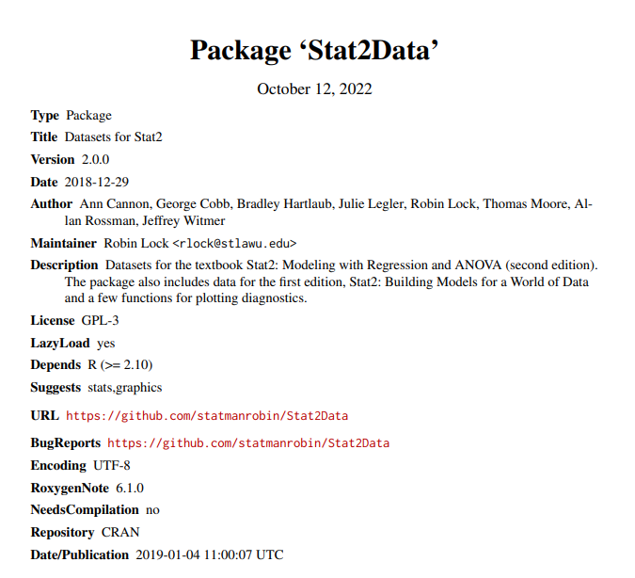
Assignment #9: Final Exam Review
Data
For each submission you should use a dataset from our textbook’s package, Stat2Data, that we have not used in class. The image is linked to the Stat2Data manual and lists all datasets that are available, as well as brief descriptions of the data.

